Slide 1
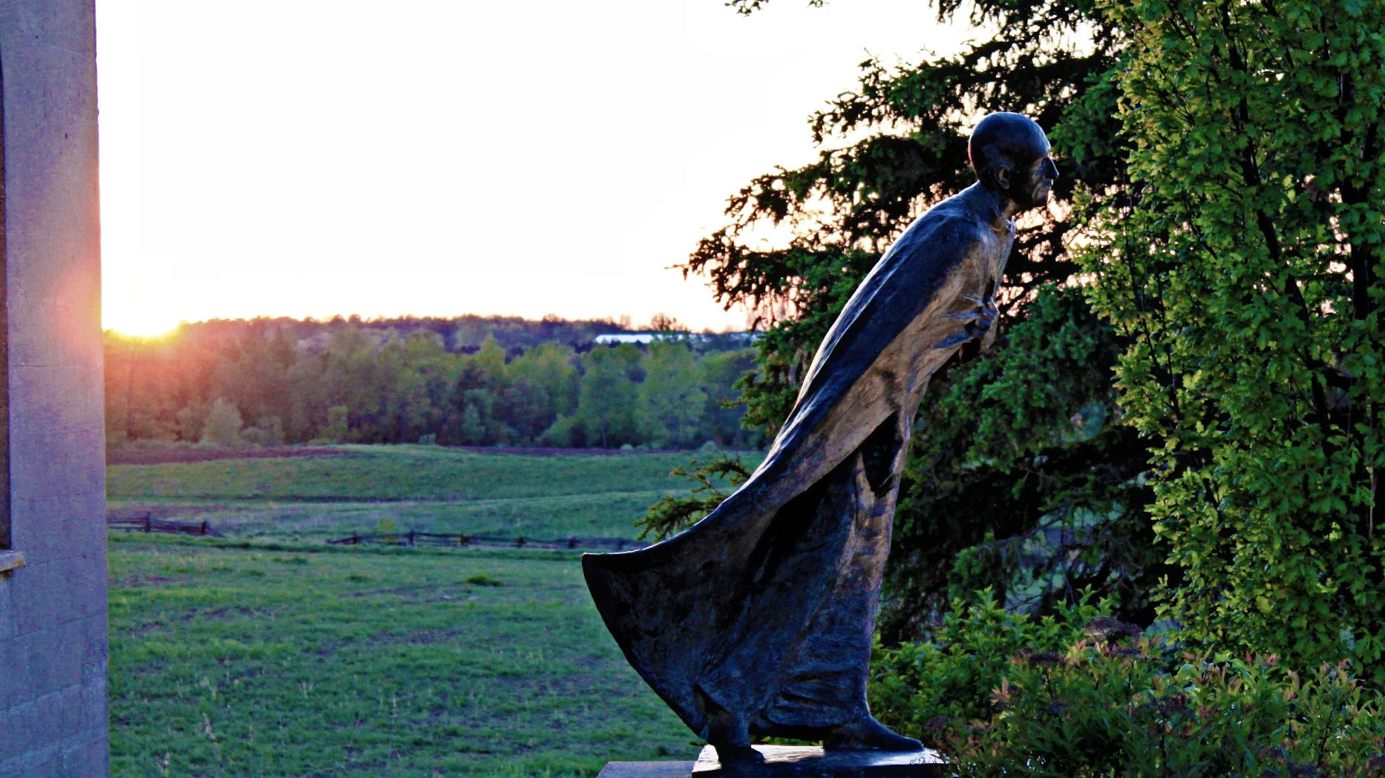
Pilgrims of Hope: Leaning into Life

Slide 3
The Pilgrim Way: Fr Michael Hansen SJ

Slide 4
The Pilgrim Way: ABOVE
14 “Do not let your hearts be troubled. Believe^{[a]} in God, believe also in me. ² In my Father’s house there are many dwelling places. If it were not so, would I have told you that I go to prepare a place for you?^{[b5} Thomas said to him, “Lord, we do not know where you are going. How can we know the way?” ⁶ Jesus said to him, “I am the way, and the truth, and the life. No one comes to the Father except through me.” (14:1-2, 5-6)

Slide 5
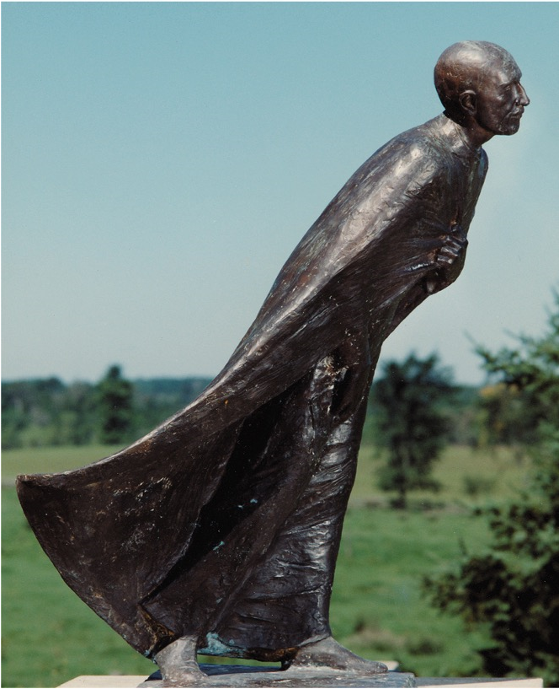
We pray: Lord, we don’t always know where we are going. Grace us with trust to enter the journey, to keep you at the centre of our lives, and to lean into the peace you offer.

Slide 6
The Pilgrim Way: WITHIN
⁸ Philip said to him, “Lord, show us the Father, and we will be satisfied.” ⁹ Jesus said to him, “Have I been with you all this time, Philip, and you still do not know me? Whoever has seen me has seen the Father. How can you say, ‘Show us the Father’? ¹⁰ Do you not believe that I am in the Father and the Father is in me? (14:8-10a)

Slide 7
We pray: Lord, the pilgrim way is one of action and contemplation. When we feel lost in chaos, overwhelmed with busyness, quieten our hearts so we can discern where you are leading us. May we lean into life, with patience, courage and trust.

Slide 8
The Pilgrim Way: THE WINDING WAYS
¹⁶I will ask the Father, and he will give you another Advocate,^{[g]} to be with you forever. ¹⁷ This is the Spirit of truth, whom the world cannot receive, because it neither sees him nor knows him. You know him, because he abides with you, and he will be in^{[h]} you.¹⁸ “I will not leave you orphaned; I am coming to you. ¹⁹ In a little while the world will no longer see me, but you will see me; because I live, you also will live. ²⁰ On that day you will know that I am in my Father, and you in me, and I in you.
(14: 16-20)

Slide 9
We pray: Lord, grace us with freedom so we can travel surprise, take the turns, align ourselves with your desire for us. May we savour your love and presence along the way so that the treasure becomes what not what we accomplish, but what we carry within.

Slide 10
The Pilgrim Way: THE JOURNEY INTO LOVE
²⁷ Peace I leave with you; my peace I give to you. I do not give to you as the world gives. Do not let your hearts be troubled, and do not let them be afraid.
Rise, let us be on our way. (John 14: 27, 31b)

Slide 11
We pray: Lord, we are designs of your love. Draw us into life with you so that we may be source of life to those we meet along the way. Rise, let us be on our way. Leaning into life, with you at our centre.

Slide 12
ON MISSION

